Slide 1
Random Forest method is used to classify the data into classes and predict the mean (regression) of the forest trees to predict Total Dollar
Step 1 – Creating a based Random Forest model and predict Y.
Step2 – Fine Tune model using RandomForestRegressor to determine optimum hyper-parameters for the best r2 score
Step3 – Finalize model by comparing r2 scores against base and fine tuned models Obtain Root Mean Square Error (RMSE) and r2
Split into attributes and label sets
Training and Testing Data
RESULTS for $ | Base Model | After 1st Tuning (n_estimators=25) | After 2nd Tuning (n_estimators=50) | Final Tuning (max_depth= 11, (n_estimators=75)
Test RMSE | 334.30 | 338.02 | 335.61 | 334.51
Test r² | 82.38% | 81.98% | 82.24% | 82.36%

Slide 2
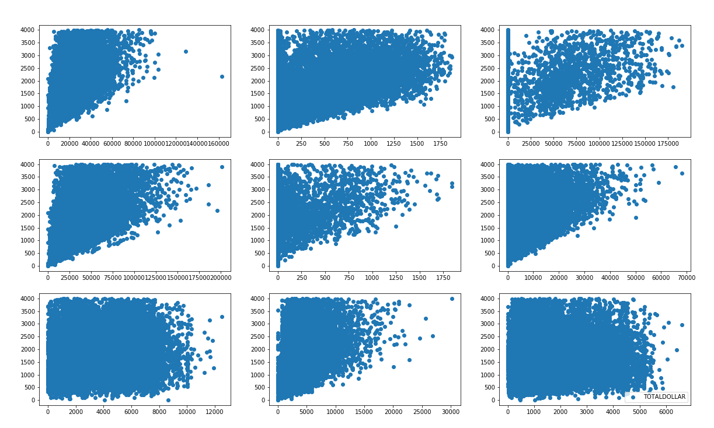
Feature Importances
Features importance is used to select features that have strong impact to the model (after training). Features that have high collinearity in the model

Slide 3
What is Random Decision Forest
A random Forest algorithm comprises of random collection of decision trees. Random Forest algorithm does creates multiple decision trees and merge them together to obtain a more robust/stable and accurate prediction. The more tree, the more robust the prediction and accuracy.
One interesting thing about Random Forest is that it can be used for both classification and regression algorithm.
Advantages/WHY
Random forest algorithm can be used for both classifications and regression task.
It provides higher accuracy.
Random forest classifier will handle the missing values and maintain the accuracy of a large proportion of data.
If there are more trees, it won’t allow overfitting trees in the model (Random forest corrects for decision tree habit of overfitting to the training data)
It has the power to handle a large data set with higher dimensionality.
Disadvantage:
With correlated features, strong features can end up with low scores and the method can be biased towards variables with many categories
The Random Forest algorithm does overfit.
The generalization error variance is decreasing to zero in the Random Forest when more trees are added to the algorithm. However, the bias of the generalization does not change.
To avoid overfitting in Random Forest the hyper-parameters of the algorithm should be tuned. For example the number of samples in the leaf.
Our Approach
The following steps were taken to create a final model.
Step 1: The data was divided into 'attributes' and 'label' sets.
The output data is then divided into training and test sets.
Step 2: We started with Base/Default algorithm/model and continue fine tuned the models by RandomForestRegressor and by adjusting n_estimators parameter, min_samples_leaf =25 and max_depth/ number of decision Trees( nodes and subsets).
This max_depth parameter defines the number of trees in the random forest.
Grow trees/fine tuned n_estimator by 20 ,50 and final tune of n_estimator=75.
https://mljar.com/blog/random-forest-overfitting/

